Slide 1

DATA 690 Practical Deep Learning
Instructor: Dr. Weizhe Li
M.P.S. in Data Science
Presented By:
Venkat Akhil Mothe
Shiva kumar Mucharla
Saikiran Mandula
Karthik Vibuthi

Slide 2


Final Project Presentation On
Pneumonia Detection
using Deep Learning

Slide 3
OUTLINE
Problem Statement
Pneumonia
Purpose
DenseNet Model
Model Accuracy
Confusion Matrix
Report
Work plan
Minimum Requirements
Sequence Diagram
Model Comparison
Performance Analysis
Frontend Interface
References

Slide 4
Problem Statement
Developing and Deploying a Deep Learning-Based Pneumonia Detection and Classification System

Slide 5
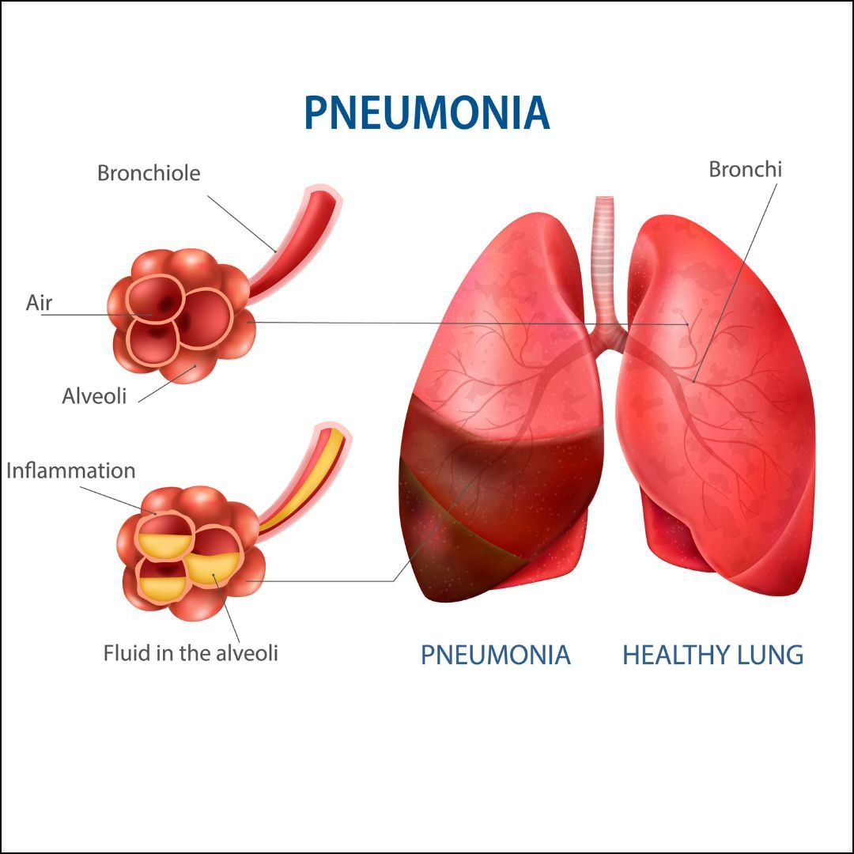
What is pneumonia??
Lung Infection: Pneumonia is an infection that inflames the air sacs in one or both lungs.
Symptoms: It often presents symptoms like cough, fever, and difficulty breathing.
Causes: It can be caused by bacteria, viruses, or fungi.

Slide 6
Purpose
Pneumonia is a bacterial disease which people overlook at early stages.
Timely detection of this disease can help us to fast-track the process of recovery.
Extraction of Chest X-rays to identify any early symptoms of pneumonia.
A system that classifies the type of pneumonia (Viral or Bacterial).
To acquire the level of precision over manual human intervention.

Slide 7
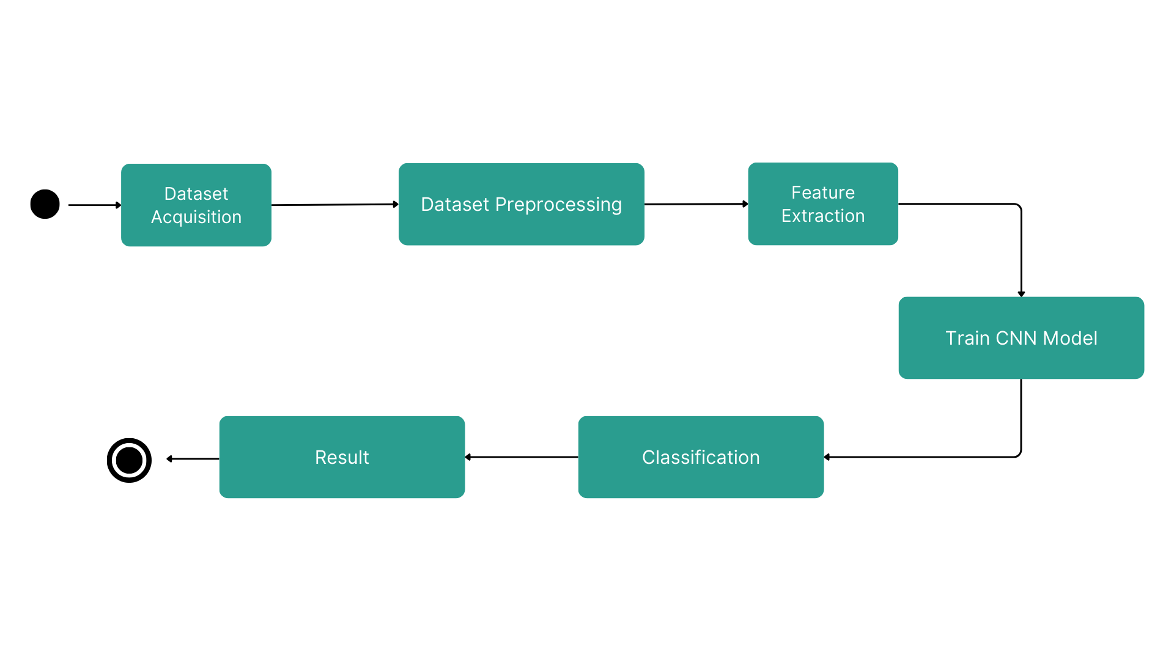
Work Plan

Slide 8
Minimum Requirements
Hardware -
Intel Core i7 @4Ghz
16GB RAM
Software and tools –
Google Colab
Jupyter Notebook
Kaggle Datasets

Slide 9
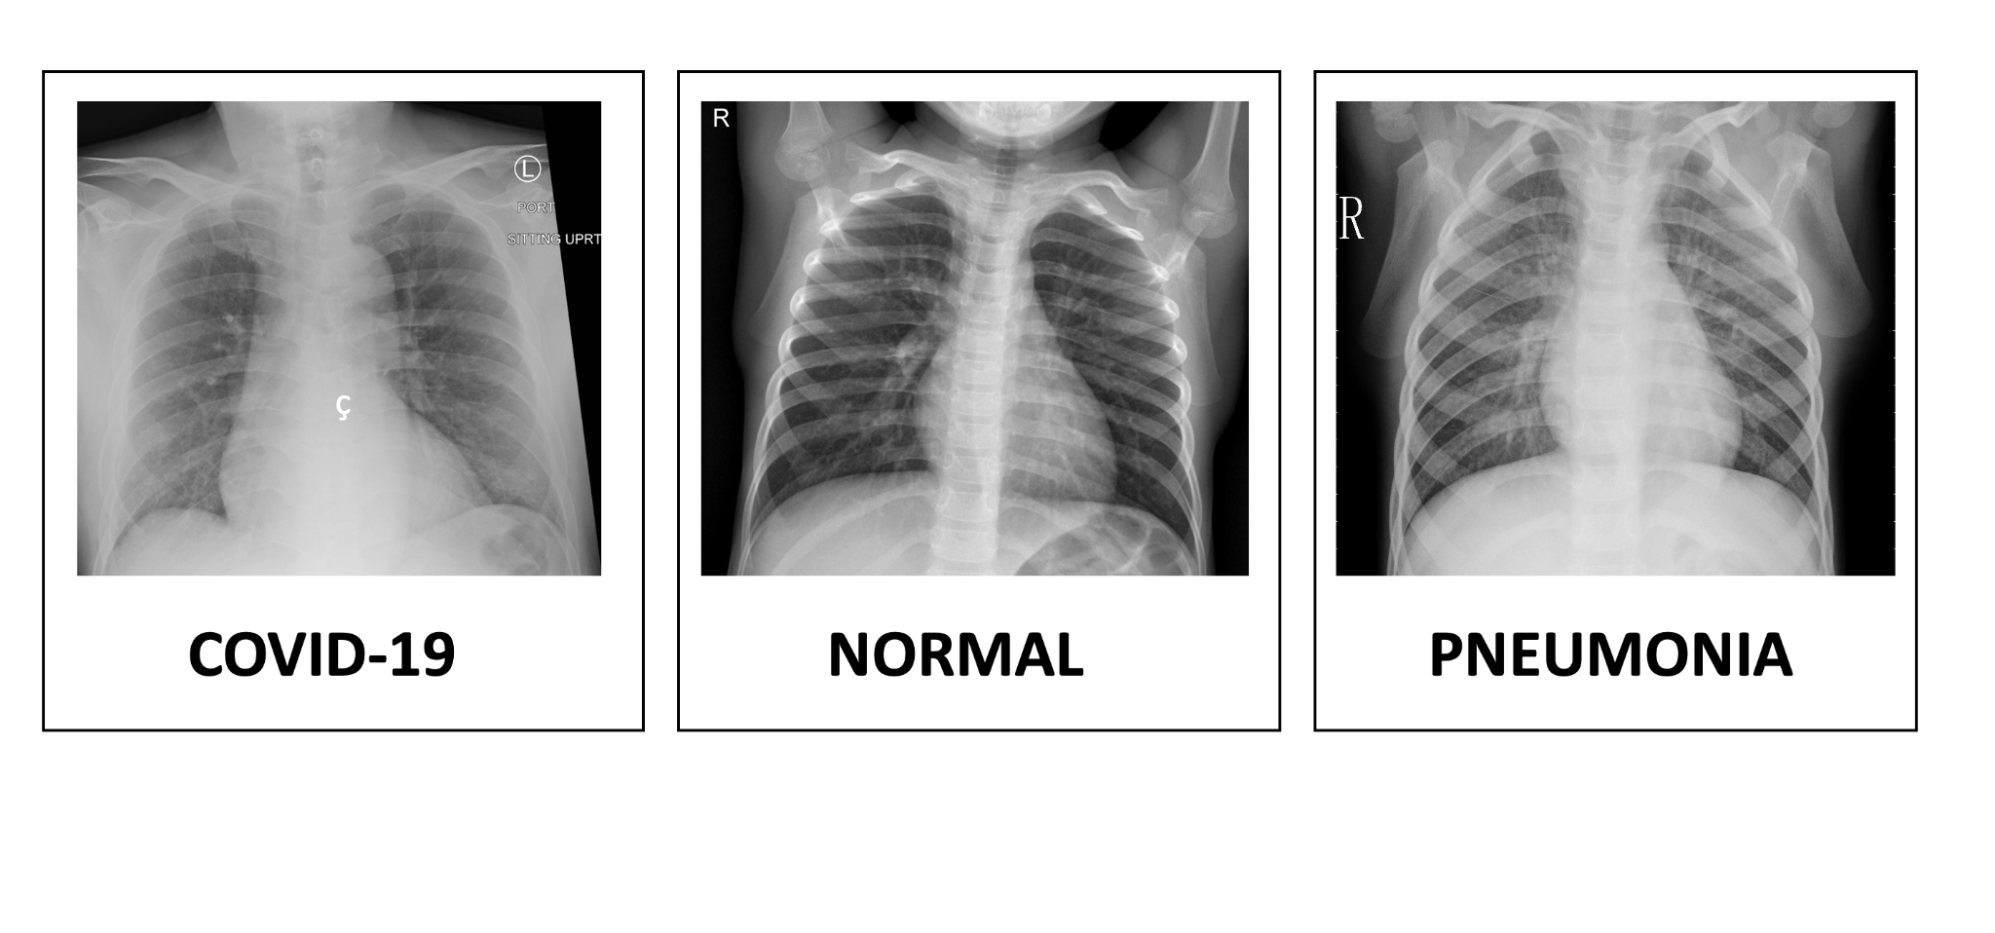
Normal
Pneumonia

Slide 10
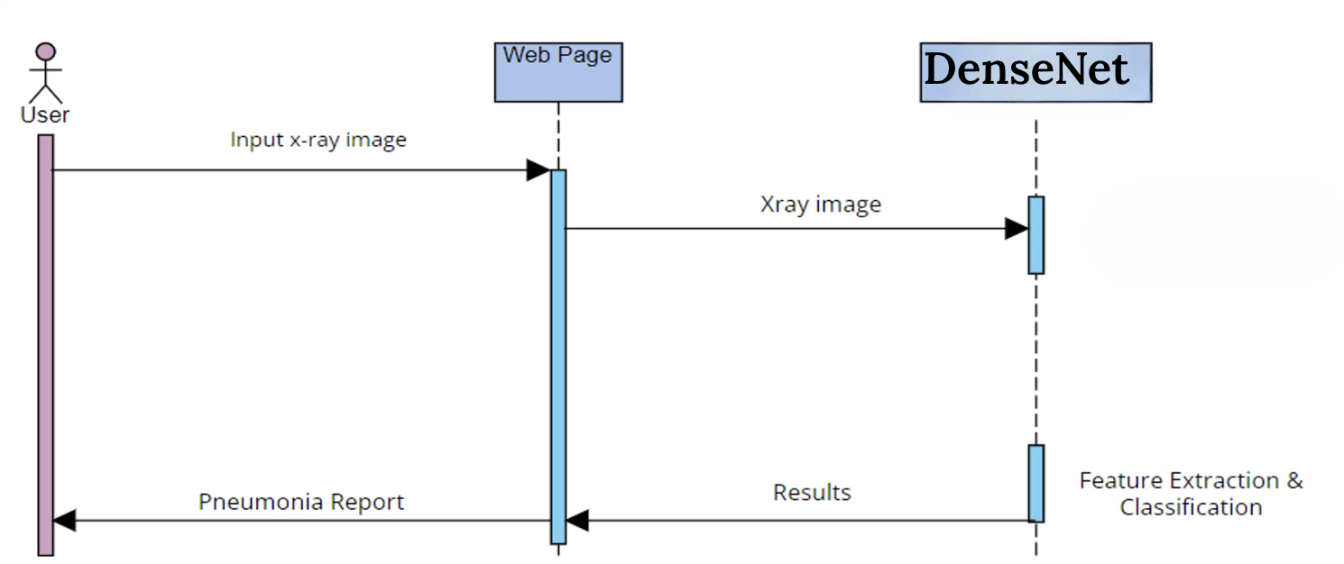
Sequence Diagram

Slide 11
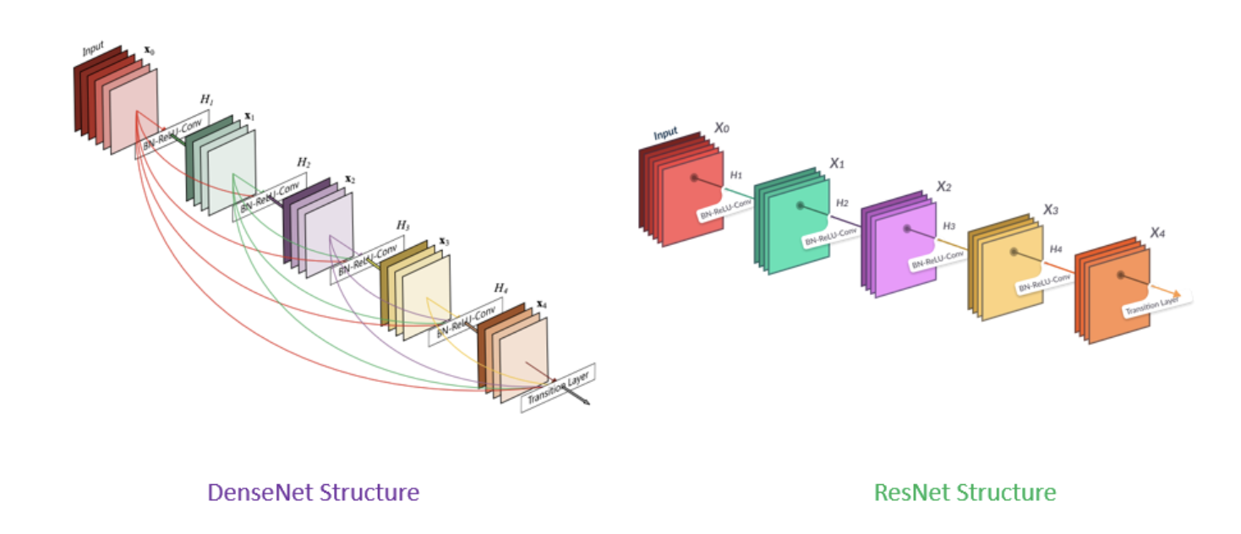
Model Comparison

Slide 12
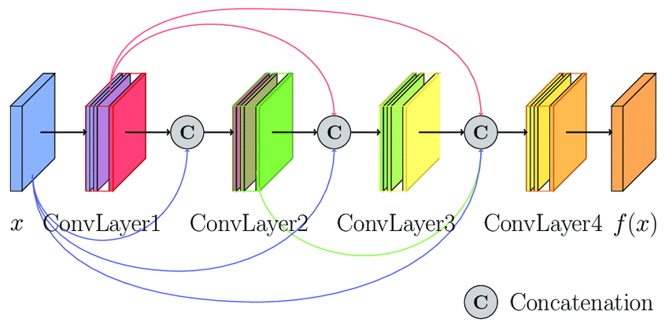
Dense Net Architecture
In dense net architecture the input of a later formed by the outputs of all the preceding layers.
Advantages are vanishing gradients
The number of layers and parameters is not very large, conv layers highlight more diverse features.
The lower conv layers take into account the low, complex patterns from the upper layers, which can be useful for detecting some low-level patterns.

Slide 13
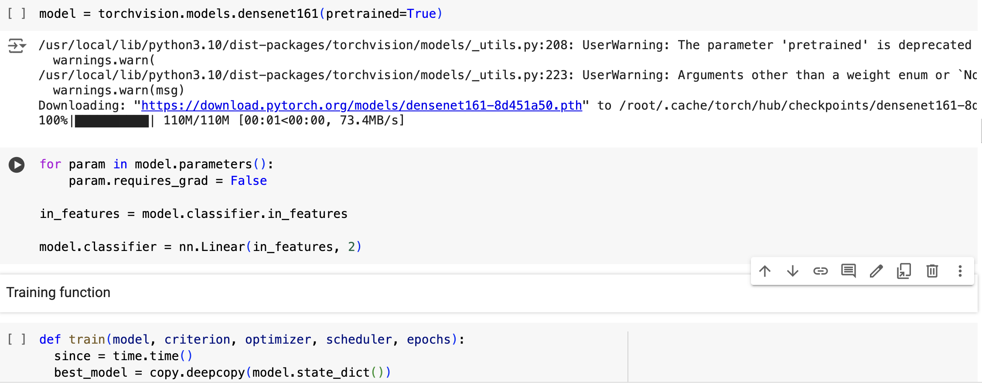
DenseNet Model

Slide 14
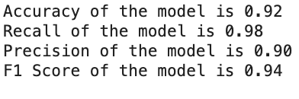
Model Accuracy
Classification Report
Precision = TruePositives / (TruePositives + FalsePositives)
Recall = TruePositives / (TruePositives + FalseNegatives)
F1 = (2 * Precision * Recall) / (Precision + Recall)

Slide 15
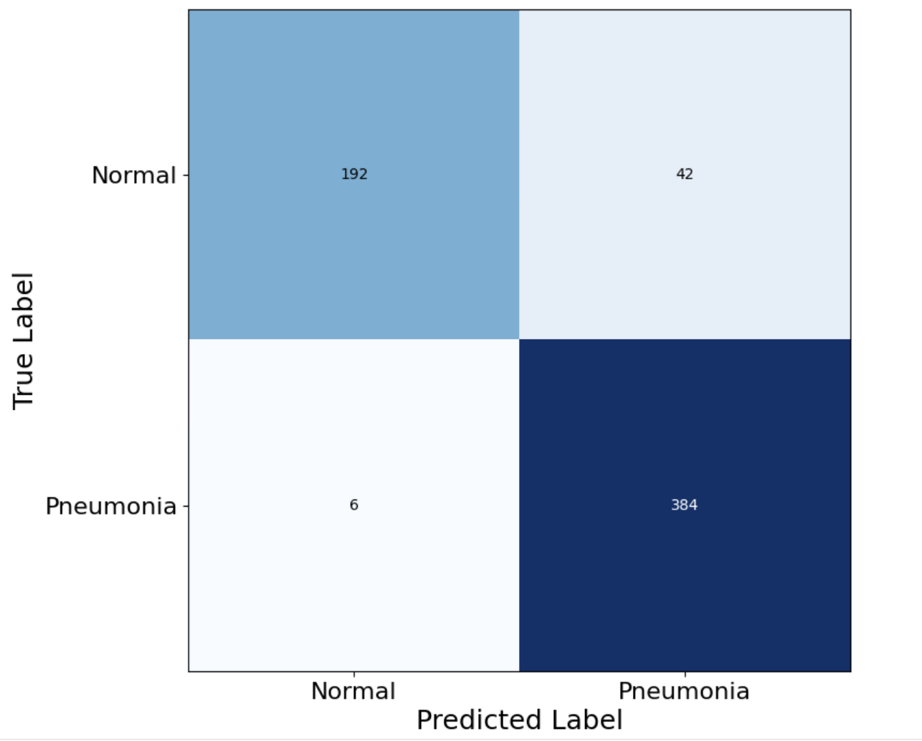
Confusion Matrix

Slide 16
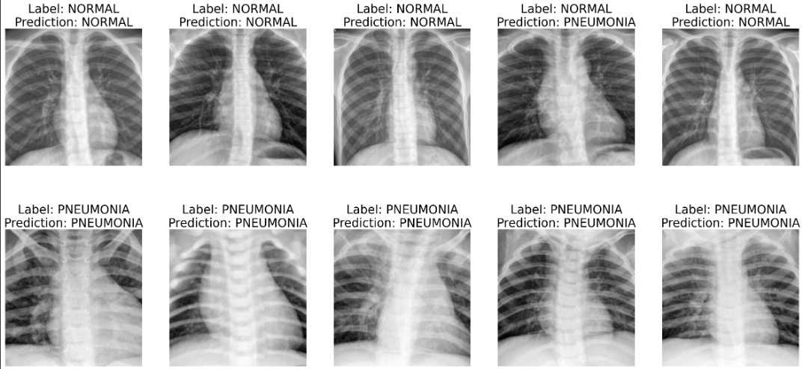
Performance Analysis:
Eventual test set results on model with 92% accuracy.

Slide 17
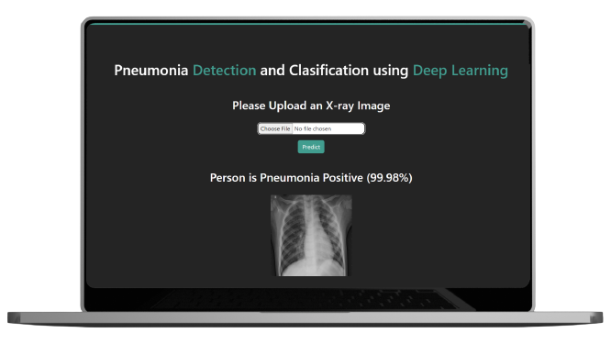
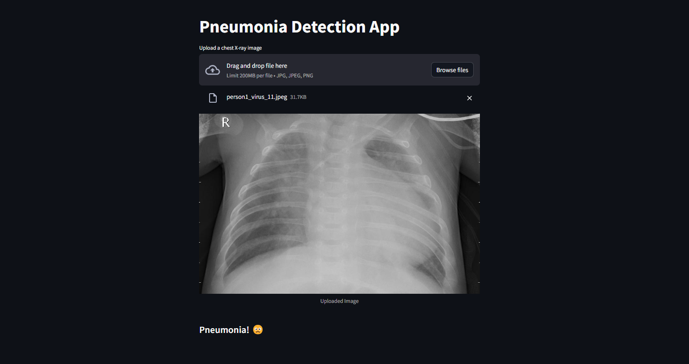
Frontend Interface

Slide 18
References
Vandecia Fernandes et al., “Bayesian convolutional neural network estimation for pediatric pneumonia detection and diagnosis”, Computer Methods and Programs in Biomedicine, Elsevier, 2021
Hongen Lu et al., “Transfer Learning from Pneumonia to COVID-19”, Asia-Pacific on Computer Science and Data Engineering (CSDE), 2020 IEEE.
Sammy V. Militante et al., “Pneumonia and COVID-19 Detection using Convolutional Neural Networks”, 2020 the third International on Vocational Education and Electrical Engineering (ICVEE), IEEE, 2021
Nanette V. Dionisio et al., “Pneumonia Detection through Adaptive Deep Learning Models of Convolutional Neural Networks”, 2020 11th IEEE Control and System Graduate Research Colloquium (ICSGRC 2020), 8 August 2020
Md. Jahid Hasan et al., “Deep Learning based Detection and Segmentation of COVID-19 & Pneumonia on Chest X-ray Image”, 2021 International Information and Communication Technology for Sustainable Development (ICICT4SD), 27-28 February 2021

Slide 19
Thank You

